Slide 1

《黄帝内经》的养生智慧
Wisdom of the Yellow Emperor（Huang Di）
and its application

Slide 2
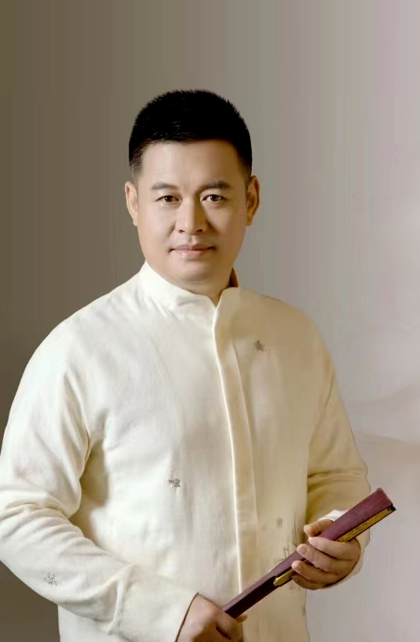
阳海导师
Yang Hai
●《黄帝内经》运用专家
● 滋慧生命文化系统创始人
● 上海滋慧书院院长
● 中滋康养生态科技集团董事长
● 世界中医药联合会
国际健康旅游专委会副会长
● Expert of the Medical Classic of the Yellow Emperor（Huang Di Neijing）, theory and practical applications.The Medical Classic of the Yellow Emperor（Huang Di Neijing） has summed up the medical achievements and clinical experiences since thousands of years,establishing the unique theoretical system of TCM and laying the foundation for the development of TCM.
● Founder of an original cultural system,Zi Hui Lifestyle.
● Head of Shanghai Zi Hui Academy.
● Chairman of Zhong Zi Health and Ecological Technology Group
● Vice chairman of International Health Tourism Committee,established in World Federation of Chinese Medicine Societies（WFCMS）

Slide 3
一、『黄帝内经』养生智慧
——从“理、法、方、药”四个纬度实践探索
Ⅰ Yellow Emperor（Huang Di）’s Theory of Human Health

Slide 4
【理】：知道者
【法】：法于阴阳
【方】：和于术数
【“药”】：食饮有节，
起居有常,
不妄作劳，
形与神俱。
THEORY：Know the right way to cultivate your health.
THERAPY：Follow the rules of Yin and Yang.
PRESCRIPTION：Respect nature and follow its ways.
HERBS：Moderate eating and drinking.
Lead a routine daily life.
Avoid overstrain or sexual intemperance.
Integrate the body and spirit.
Chinese ancients believe the natural span of life was at least 120 years.By going through all the above,you may enjoy the allotted span for more than120 years yourself.
尽终天年（120岁）

Slide 5
二、滋慧生命文化系统
已帮助6万+ 企业家实现
个人家族企业健康
We have helped more than 60,000 Chinese entrepreneurs with personal health and corporate wellness.

Slide 6
提出养生的三大战略思想：
健康是一种修养
养生是一种教育
生命是一次悟道的旅行
Three important theories about health:
Health is a principal virtue.
Keep health need to be educated.
Life is a tour with spiritual practice.

Slide 7
《黄帝内经》活法：
一套心法：神旺
一套功法：气足
一套吃法：精满
Revivals of Yellow Emperor（Huang Di）’s Lifestyle :
A proven meditation program,to keep mental health.
A proven exercise program,to keep immune health.
A proven diet program,to keep physical health.

Slide 8
《黄帝内经》修行系统：
【治企篇】：领袖思维
【齐家篇】：家族春天
【修身篇】：见性禅
Revivals of Yellow Emperor（Huang Di）’s spiritual practice:
Leadership,the wisdom of corporate management.
Family Gene,the wisdom of family ties.
Jianxing Zen, the wisdom of self-improvement.

Slide 9
三、部分案例分享
Ⅲ Case Study

Slide 10
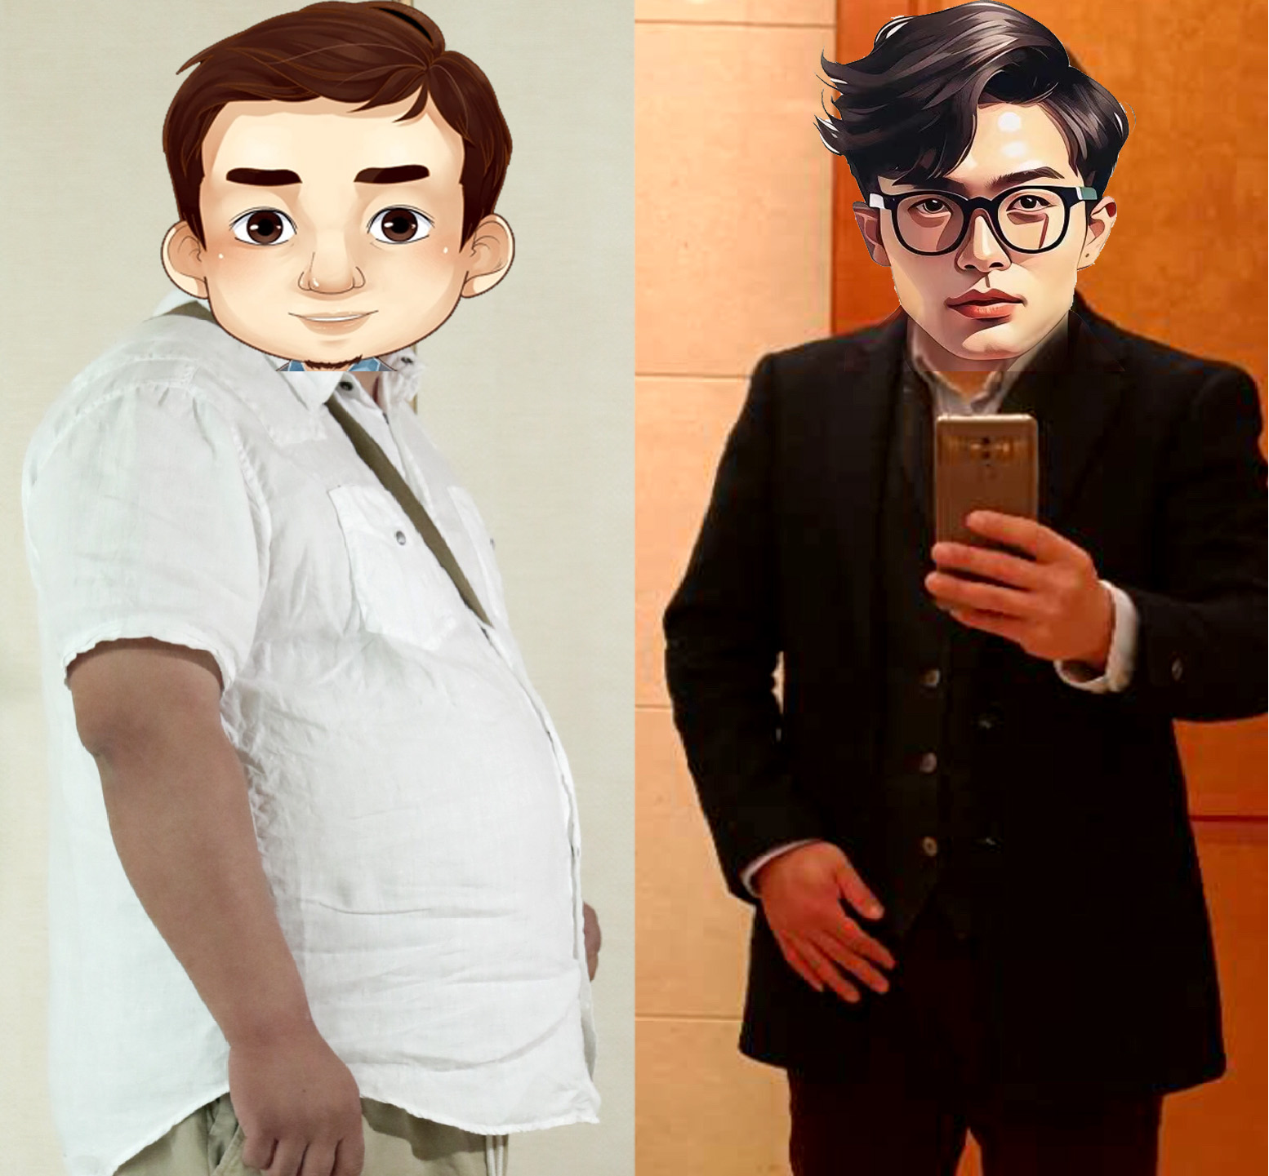

Slide 11
Mr.Meng
From the 31th course
Before resort：112.4kg
After resort：Reduced to his biological ideal weigh as 80 kg.
BP lowered from 142/100 to 116/76.
Fasting blood glucose reduced from 7.6mmol/L
to 4.8 mmol/L.
Hypertriglyceridemia lowered from 2.22 mmol/L to 1.24mmol/L.
LDL lowered from 4.04mmol/L to 1.24mmol/L.
TC lowered from 4.69 mmol/L to 3.79 mmol/L.
Steatohepatitis got healed.
第31期学员: 孟先生
体重从224.8斤降至160斤
减重64.8斤
血压从142/100降至116/76
原空腹血糖7.6mmol/L
现空腹血糖4.8 mmol/L
甘油三酯从2.22降至1.24
低密度从4.04降至1.24
总胆固醇从4.69降至3.79
重度脂肪肝消失。

Slide 12
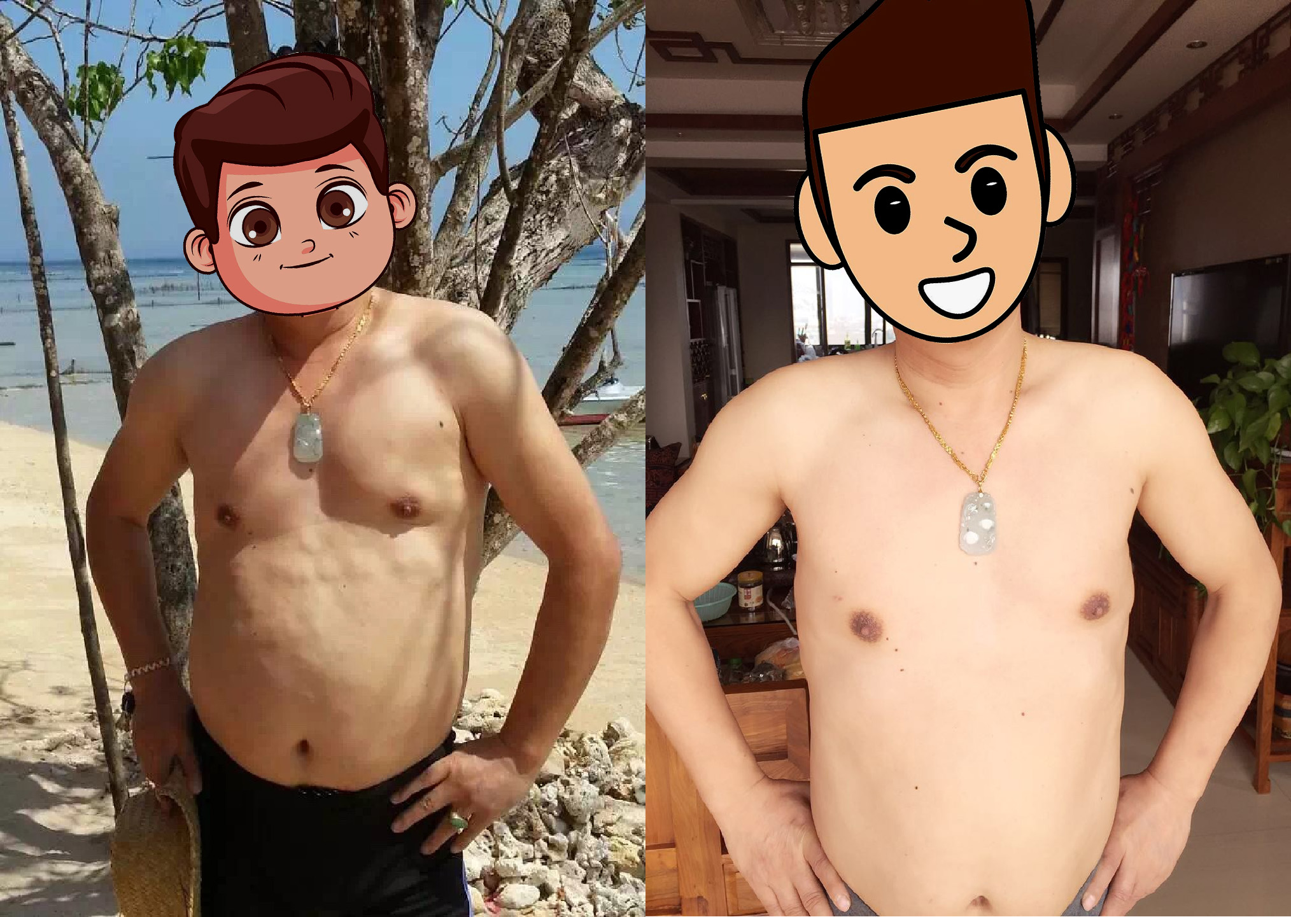

Slide 13
第18期学员 ：胡先生
腹部脂肪瘤基本消失。
空腹血糖从11.8 降至6.3 左右，胰岛素停用，降糖药减半。
Mr.Hu
From the 18th course
After resort：Abdominal lipoma got largely disappeared.
Fasting blood glucose reduced from 11.8mmol/L to 6.3mmol/L,
eliminated the need for insulin injection and reduced the need for oral diabetes medications.

Slide 14
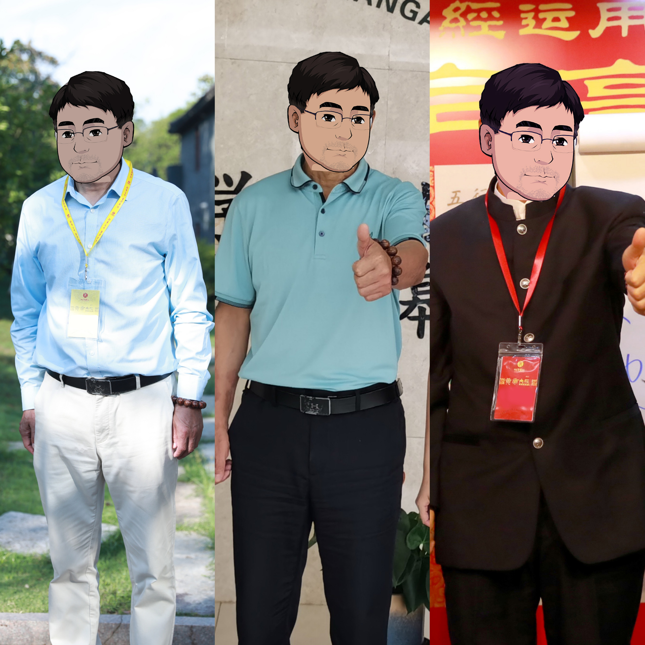

Slide 15
第88期学员: 周先生
7粒降糖药停服
晚间16个单位的胰岛素停用
右侧甲状腺结节消失
双肾结石消失
十几年的牛皮癣消失
养护之前胰岛素水平是2.94，养护之后胰岛素水平是5.31
Mr.Zhou
From the 88th course
After resort：Insulin level raised from 2.94mU/L to 5.31mU/L,
eliminated the need for oral diabetes medications and insulin injection.
Thyroid nodule and kidney stones got disappeared.Psoriasis got healed.

Slide 16
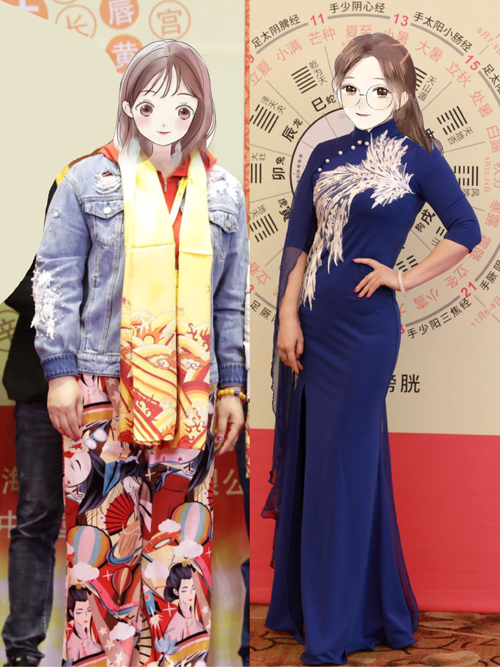

Slide 17
第55期学员: 曹女士
体重从142斤降至115斤
减重27斤
肌肉量增加
长期胃痛症状消失
睡眠质量提高
Ms.Cao
From the 55th course
Before resort：71 kg
After resort：Reduced to her biological ideal weigh as 57.5 kg with muscle growth.Constant stomachache got healed and sleep quality got actually better.

Slide 18
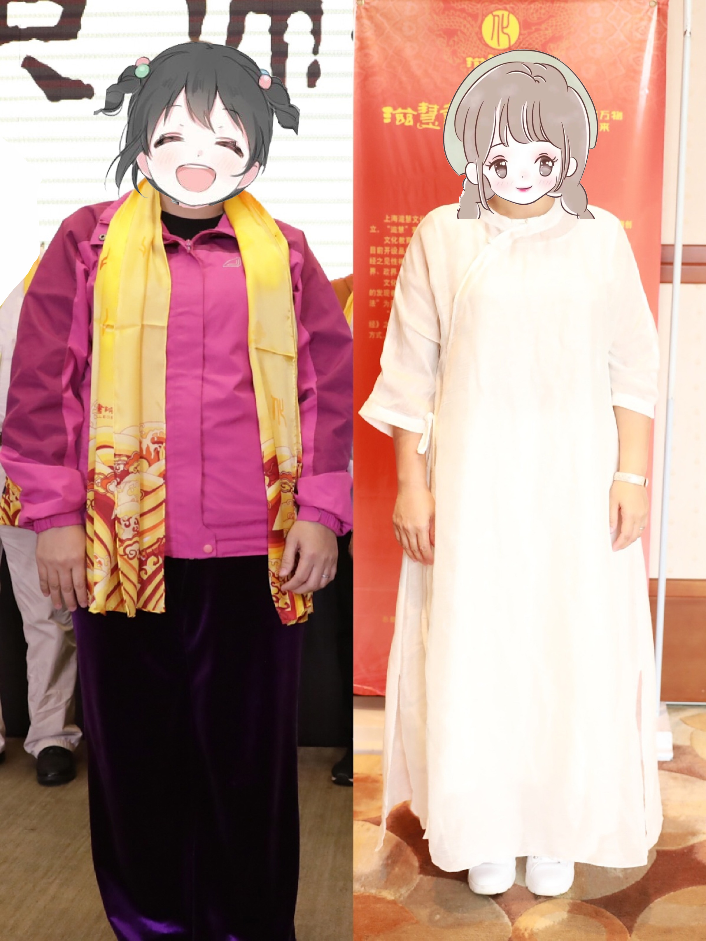

Slide 19
第51期学员: 欧女士
体重从170.2斤降至137.2斤
总减重33斤；
气色得到提升；
精神状态提升。
Ms.Ou
From the 51st course
Before resort：85.1 kg
After resort：Reduced to her biological ideal weigh as 68.6 kg.Skin complexion got improved.

Slide 20
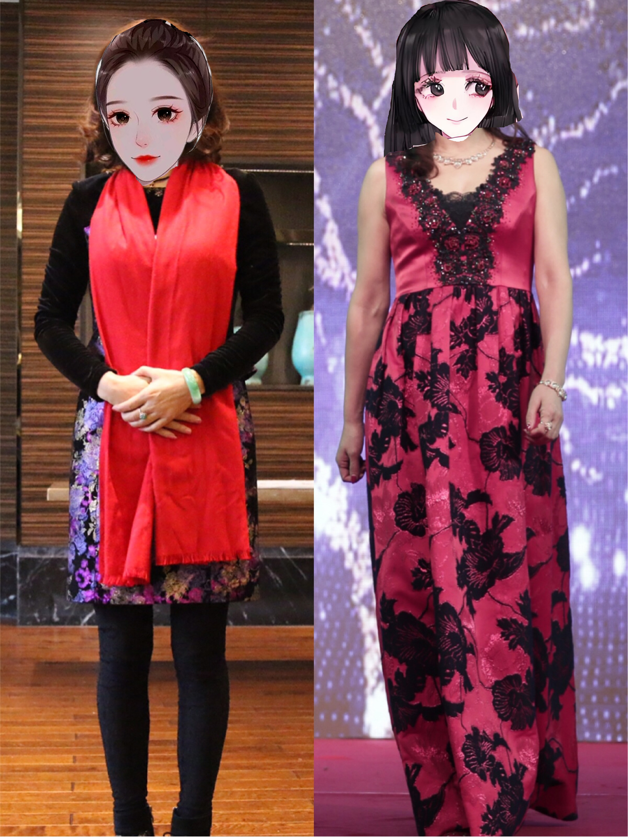

Slide 21
第18期学员：李女士
原体重：102斤
现体重：112.5斤
增重10.5斤
乙肝康复。
Ms.Li
From the 18th course
Before resort：51 kg
After resort：Gained up to her biological ideal weigh as 56.25 kg,
while the chronic Hepatitis B got functional cured.

Slide 22
滋慧书院的使命
让天下人健康起来
We dedicate to health of every single human.
谢谢大家！
Thanks for listening！

