Slide 1

非遗绮针7疗
Intangible Heritage 7 Therapy with Beautiful Needles
—之异病同治
- Treating Different Diseases with the Same Method
绮针7疗品牌与著作人王卓倬
Wang Zhuozhuo, Founder and Author of 7 Therapy with Beautiful Needles
主讲人：王卓倬
Speaker: Wang Zhuozhuo

Slide 2
目录
Catalog
01
02
03
04
传承人介绍
Inheritor Introduction
绮针7疗的特点
Characteristics of 7 Therapy with Beautiful Needles
绮针阴阳平衡关系
Relationship to Yin and Yang and Balance of 7 Therapy with Beautiful Needles
绮针临床应用
Clinical Applications of 7 Therapy with Beautiful Needles

Slide 3
传承人介绍
/ 01
Inheritor Introduction

Slide 4
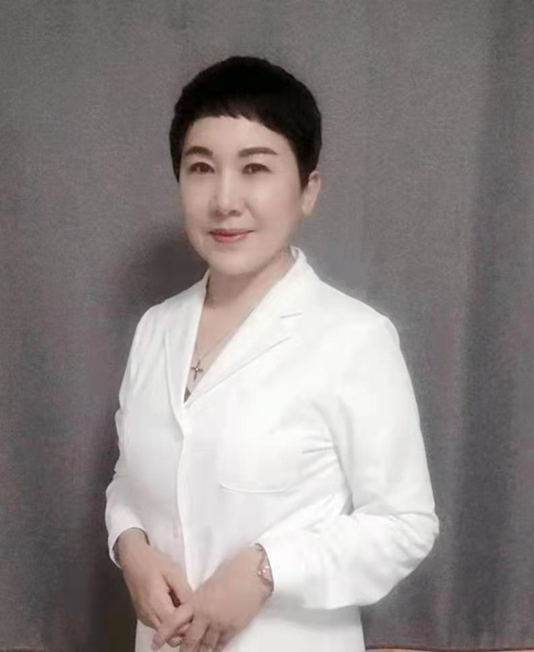
绮针7疗传承人介绍
Introduction to the Inheritor of 7 Therapy with Beautiful Needles
中医传承人-中国工程院院士国医大师石学敏弟子
法律公证《国际针灸医师》
国家二级心理咨询师
Traditional Chinese medicine inheritor - Disciple of Shi Xuemin, master of Traditional Chinese Medicine and academician of Chinese Academy of Engineering
Legal notarized International acupuncturist
National second level psychological consultant
北京《国针益草》中医院创始人-院长
焯仁众康国际健康管理（北京）有限公司董事长
President and Founder of Beijing “National Needle and Benificial Herbs”TCM Hospital
Chairman of Zhuoren Zhongkang International Health Management (Beijing) Co., Ltd.
中华中医药学会中医药健康产学研联盟会常务理事
中国民族医药学会科普分会副会长
中国民族医药学会科普分会人才库专家
香港国际美医健联合学会常务理事、北京分会会长
Executive director of the Association of Production, Education and Research for Chinese Traditional Medicine and Science
Vice President of Council of Popular Science Branch of China Medical Association of Minorities
Talent Pool Expert of Council of Popular Science Branch of China Medical Association of Minorities
Standing Director of Hong Kong International Association of Beauty, Medicine and Health, and President of its Beijing Branch
2017年作为中国中医代表参加第十四届世界中医药大会，作为嘉宾代表参加选举
2019年9月特邀参加第七届中欧中医药国际合作与发展论坛暨首届弗罗伊登传统医学高峰论坛，作为嘉宾代表就绮针7疗疑难杂症与慢性病临床效果报告发言
荣获2021年世界GMAEA唯一全球中医文化传承奖
荣获2024年1月首届中马中医高峰论坛绮针7疗优秀技术奖与个人贡献奖
Participated in the 14th World Congress of Chinese Medicine in 2017 as a representative of Chinese medicine in China, and participated in the election as a guest representative
In September 2019, invited to participate in the 7th Sino-European Forum on International Cooperation and Development of Traditional Chinese Medicine and the First Froeden Summit Forum on Traditional Medicine as a guest representative to make a report speech on the clinical effects of Qizhen 7 Therapy for difficult cases and chronic diseases
Awarded the only Global TCM Cultural Heritage Award by the World GMAEA in 2021
Awarded the Qizhen 7 Therapy Outstanding Technology Award and Individual Contribution Award at the First Sino-Malaysian TCM Summit in January 2024
王卓倬 字：家绮
Wang Zhuozhuo Courtesy name: Jiaqi

Slide 5
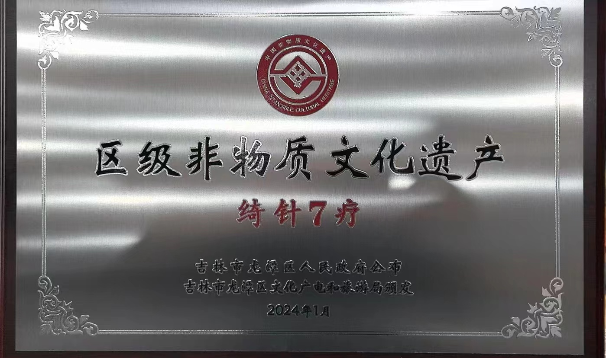
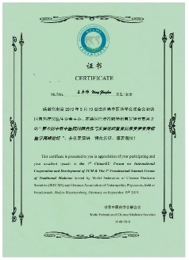
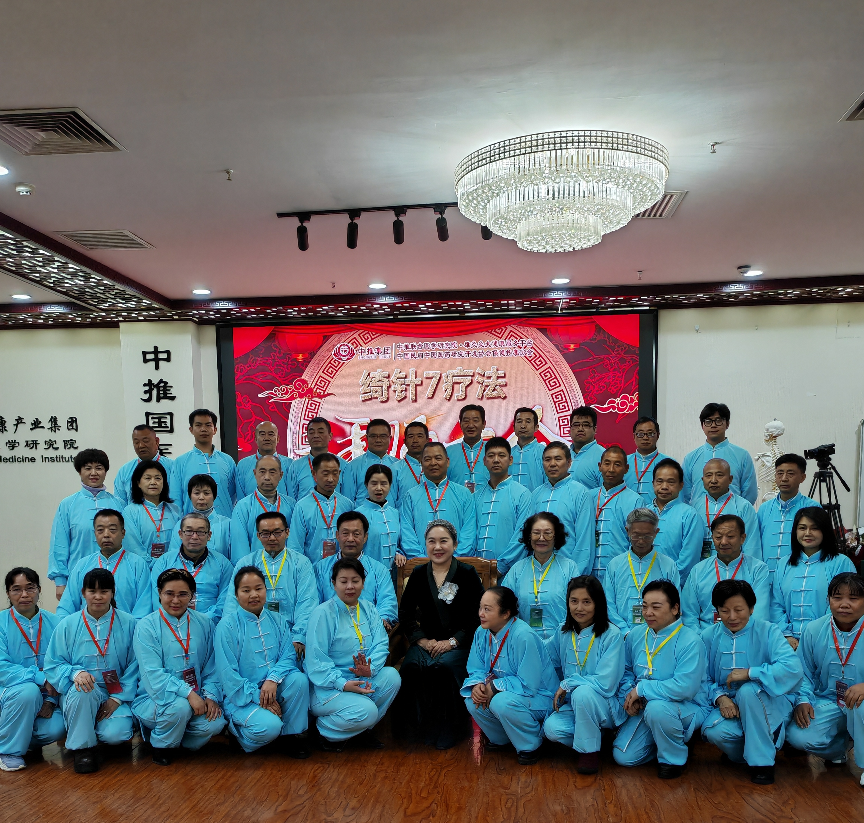
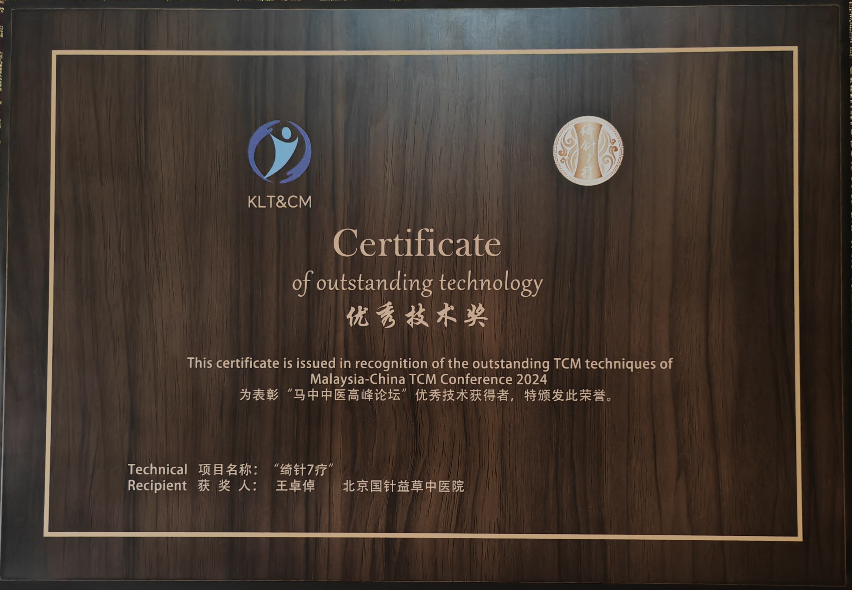
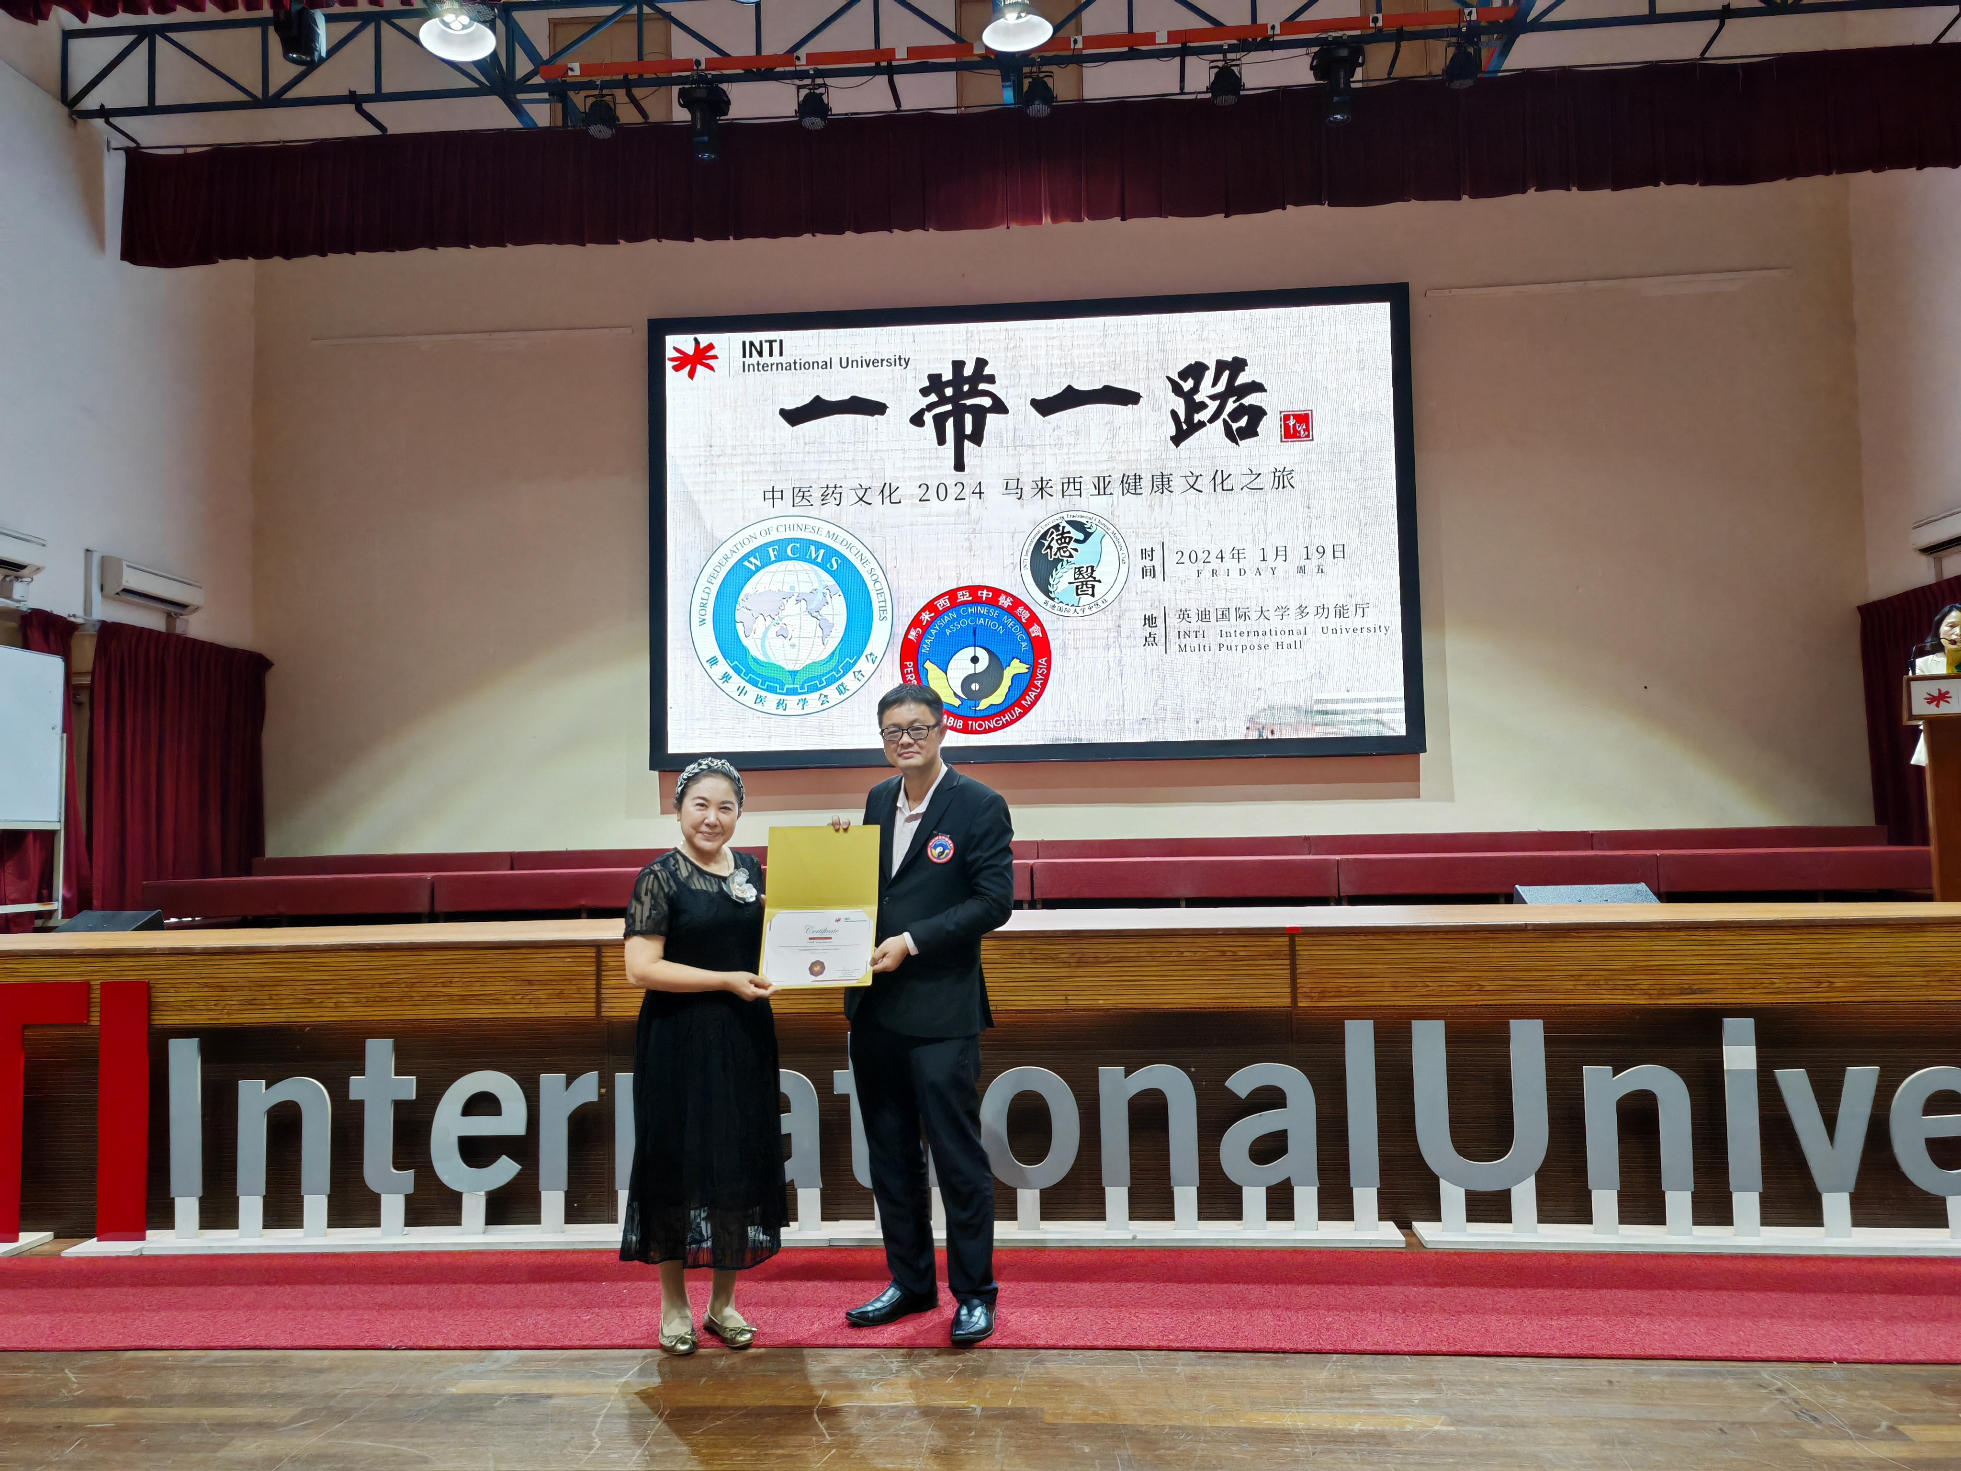
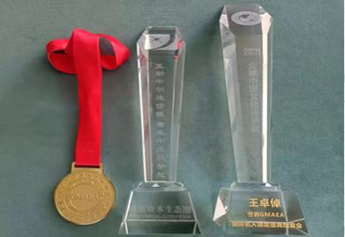
部分荣誉
Partial Honors

Slide 6
绮针7疗介绍与特点
/ 02
Introduction and Characteristics of 7 Therapy with Beautiful Needles

Slide 7
绮针7疗简介
Introduction of 7 Therapy with Beautiful Needles
做为绮针7疗的传承人坚持20余年不断学习与创新发展，达万人以上临床经验总结见证效果。
坚守遵循严谨的学科，本着安全、有效、无副作用、从根本系统解决疾病问题原则； 做到专业实用，简单易学，复制性强，以广泛传承……
As the inheritor of the 7 Therapy with Beautiful Needles, I have persisted in continuous learning and innovation for over 20 years, accumulating clinical experience witnessed by tens of thousands of cases.
I adhere to the rigor of the discipline, based on the principles of “safety, effectiveness, no side effects, and fundamentally and systematically solving health issues”;
I strive to be professional and practical, making the method easy to learn and highly replicable, in order to widely disseminate and pass on the knowledge...

Slide 8
绮针7疗特点
Characteristics of 7 Therapy with Beautiful Needles
一个心愿：打造百万家庭“医生”不是医生胜是医生，健康你我他！
二个特质：离穴不离经，不留针远端治疗！
三个基本点：辨证准确，直达病灶平衡区，疗效立竿见影！
四大原则：安全、有效、无副作用、从根本系统解决疾病问题！
五大调理体系：专业实用、简单易学、复制性强、临床应用见效快、得以广泛传播！
六大遵循：上病下治、下病上治；左病右治、右病左治；后病前治、前病后治；内病外治;异病同治、同病异治！
七大解决特点：阴阳、相对、平衡、反应、离子道、生物电、无局限性！
八见效快：每种疾病秒杀……
九临床见证：一次见效！
One Wish: To create “family doctor”for millions of households, not a doctor but better than a doctor, for the health of you, me, and everyone!
Two Characteristics: Leaving the acupoint without leaving the meridian, performing distant treatment without retaining the needle!
Three Basic Points: Accurate diagnosis, targeting the disease's balance area directly, with immediate therapeutic effects!
Four Major Principles: Safety, effectiveness, no side effects, and fundamentally and systematically addressing health issues!
Five Major Regulatory Systems: Professional and practical, easy to learn, highly replicable, quick to show clinical effects, and widely disseminated!
Six Adherences: treating diseases at bottom part for the top part and vice versa, at right part for the left part and vice versa, and at outer part for the inner part and vice versa; treating different diseases with the same method, and the same disease with different methods!
Seven Key Features of Problem Solving: Yin and Yang, relativity, balance, reactivity, ionic pathways, bioelectricity, and no limitations!
Eight Quick Effects: Swiftly addressing every disease...
Nine Clinical Testimonies: Immediate effect with a single treatment!

Slide 9
绮针与阴阳平衡关系
/ 03
Relationship to Yin and Yang and Balance of 7 Therapy with Beautiful Needles

Slide 10
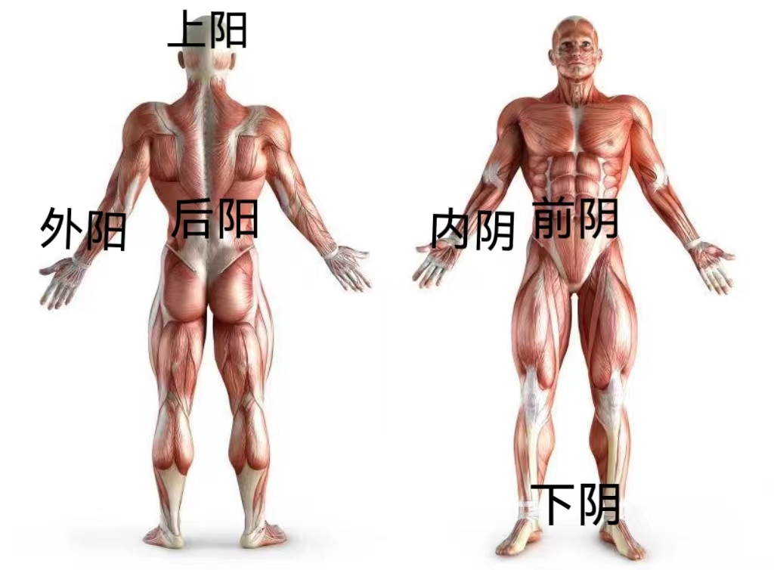
绮针与阴阳、平衡的关系
Relationship to Yin and Yang and Balance of 7 Therapy with Beautiful Needles
Upper Yang
素问·金匮真言论篇第四有云：“夫言人之阴阳，则外为阳，内为阴。言人身之阴阳，则背为阳，腹为阴。”
又《灵枢·寿夭刚柔》曰：“是故内有阴阳，外亦有阴阳。在内者，五脏为阴，六腑为阳；在外者，筋骨为阴，皮肤为阳。
In the Suwen (Simple Questions), the fourth chapter Jinkui Zhenlun (The True Discourse of the Golden Casket), it is stated: 'When speaking of the Yin and Yang of a person, the exterior is considered Yang, and the interior is considered Yin. When speaking of the Yin and Yang within the body, the back is Yang, and the abdomen is Yin.'
Furthermore, in Lingshu (The Spiritual Pivot), the chapter Shouyao Gangrou (Longevity, Short Life, Rigidity, and Softness), it is said: 'Therefore, there is Yin and Yang within, and there is also Yin and Yang without. Internally, the five zang organs are Yin, and the six fu organs are Yang; externally, the bones and sinews are Yin, and the skin is Yang.
Outer Yang Rear Yang Inner Yin Front Yin
Lower Yin

Slide 11
绮针与阴阳、平衡的关系
Relationship to Yin and Yang and Balance of 7 Therapy with Beautiful Needles
Upper Yang
上阳下阴、 后阳前阴、 外阳内阴，身体阴阳平衡=健康。
我对阴阳的理解就是矛盾的、对立统一的、相互转化的。即“阴病阳治、阳病阴治”，上病下治、 下病上治、 左病右治、 右病左治 后病前治、 前病后治、 内病外治，同病异治、异病同治。
Yang above and Yin below, Yang at the back and Yin at the front, Yang on the outside and Yin on the inside. The balance of Yin and Yang in the body = health.
My understanding of Yin and Yang is that they are contradictory, unified in opposition, and can transform into each other. That is to say,“treating Yin diseases with Yang and vice versa”; treating diseases at bottom part for the top part and vice versa, at right part for the left part and vice versa, and at outer part for the inner part and vice versa; treating the same disease with different methods, and different diseases with the same method.
Outer Yang Rear Yang Inner Yin Front Yin
Lower Yin

Slide 12
临床应用与效果
/ 04
Clinical Applications and Effects

Slide 13
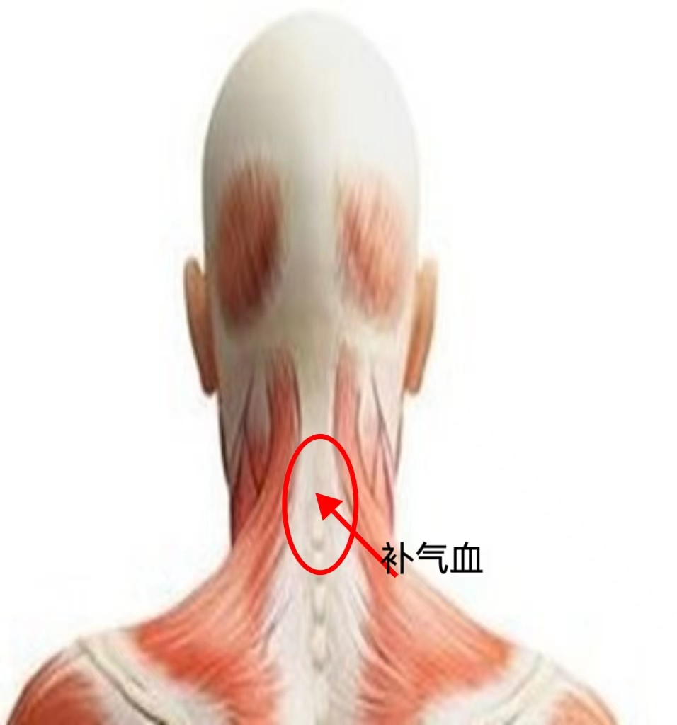
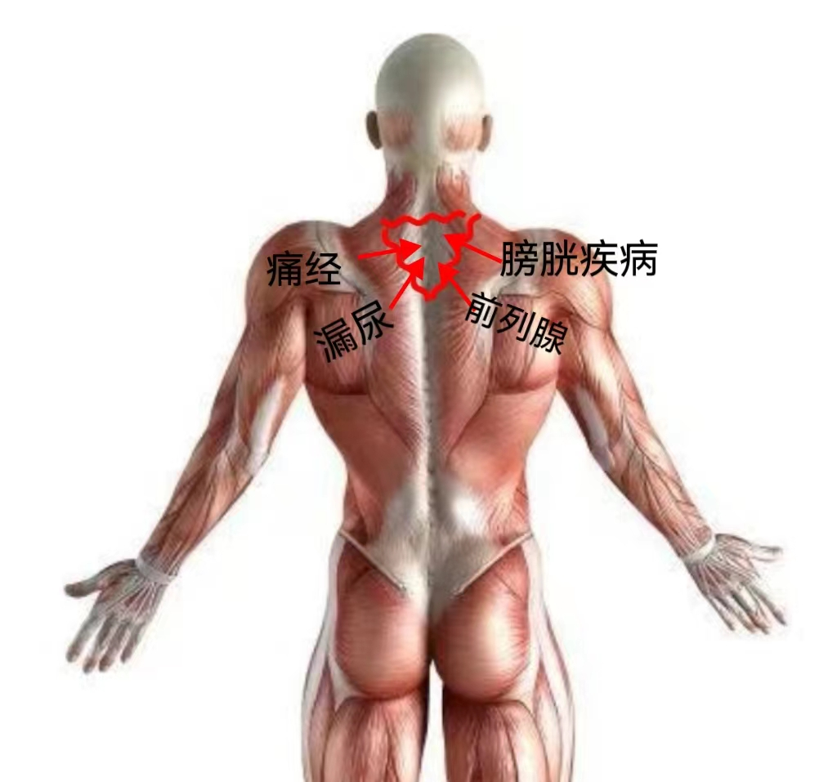
绮针临床应用之异病同治
Treating Different Diseases with the Same Method of 7 Therapy with Beautiful Needlesn
绮针疗法：
1、针法（刃针0.35*50或0.40*50）：消毒-颈椎3-5节之间直刺到骨膜层，打开开关（补气血），每周1次即可；
(1)用刮痧方法找出人体疾病点，再用针打开开关;
(2)遇到有条索、结节、经结、筋结再用针打开开关即可。
2、针刺(毫针0.3*60或0.35*75)：消毒-在大椎直刺，上下提针点刺3~5下后，即出针，用消毒棉球按压即可。
疗程：每天只少1次，前3天连续，10次为一个疗程
Therapy of 7 Therapy with Beautiful Needles:
1. Acupuncture therapy (bladed needle 0.35*50 or 0.40*50): Disinfection - Insert the needle vertically between the third and fifth cervical vertebrae until it reaches the periosteum layer, turn on the switch (to replenish qi and blood), and perform this once a week.
(1) Use the scraping method to identify disease points on the body, then use the needle to turn on the switch;
(2) When encountering bands, nodules, meridian junctions, or muscle knots, simply use the needle to turn on the switch.
2. Filiform needle puncture (filiform needles 0.3*60 or 0.35*75): Disinfection -Puncture directly to the Dazhui acupoint. After puncturing for 3 ~ 5 times from the upper and lower points, the needle is released and the punctured parts are pressed with sterilized cotton balls.
Course of treatment: At least once per day, and ten times per course of treatment.
Nourish Qi and Blood
Dysmenorrhea
Leakage urine
Bladder disease
Prostate

Slide 14
绮针临床应用之异病同治
Treating Different Diseases with the Same Method of 7 Therapy with Beautiful Needles
案例实操：
Case Practice:
说的好、不如做的好！
欢迎有痛经或前列腺嘉宾上来临床实操体验见证效果！
Actions speak louder than words!
Guests suffering from dysmenorrhea or prostate problems are welcome to come up to the clinical practice to experience and witness the effect!

Slide 15

谢谢聆听！
Thank you for listening!

